Slide 1
Three-dimensional maps of folded genomes
Lieberman-Aiden et al., “Comprehensive mapping of long-range interactions reveals folding principles of the human genome,” Science 2009, 326(5950):289-93
Presented by Hershel Safer in the group meeting of Ron Shamir’s group on 29.12.2010.

Slide 2
Outline
Context
Some biological background
Experimental technique & validation
Findings

Slide 3
Conformation enables interactions
Activity in the cell’s nucleus depends on physical interactions: DNA functional elements can only interact if they are physically close in 3D space.
So the 3D conformation of chromosomes determines possible interactions between two loci:
Folding of individual chromosomes: interactions between loci on the same chromosome (intra-chromosomal)
Relative locations of chromosomes: interactions between loci on different chromosomes (inter-chromosomal)
We want to understand the 3D conformation of chromosomes so that we can identify potential interactions between DNA loci.

Slide 4
Interactions imply conformation
We don’t know how to model chromosome folding & localization well enough to do a good job of predicting interactions between DNA loci.
This group investigated an experimental way to identify all interactions directly rather than via computational predictions.
The direction of inference therefore becomes the opposite of that described on the previous slide:
We wanted to use predictions of chromosomal conformation to infer interactions between loci.
Instead, we use information about interactions to infer the 3D conformation (folded shape & relative locations).
Knowing the conformations is of independent interest.

Slide 5
Previous work on identifying interactions
A key method for identifying interactions has been Chromosome Conformation Capture (3C) [Dekker, Science 2002].
Formaldehyde fixation is a technique for cross-linking proteins to other proteins and to DNA.
Formaldehyde fixation is used to cross-link genomic loci that are touching. It does this by using contacts between proteins that are bound to the DNA.
The frequency of cross-linking between given pairs of regions is then determined using a somewhat complex series of experimental reactions.
One step in the process is quantitative PCR.

Slide 6
Drawback of 3C & its extensions
The PCR step uses a specific primer for each locus of interest. This means that 3C can only be used to identify interactions between pre-selected loci.
3C could be used on all possible loci for a genome of known sequence, but this would be a massive & wasteful undertaking.
The goal of the work described in this paper is to develop a method for performing an unbiased genome-wide analysis of interactions between DNA loci.

Slide 7
Outline
Context
Some biological background
Experimental technique & validation
Findings

Slide 8
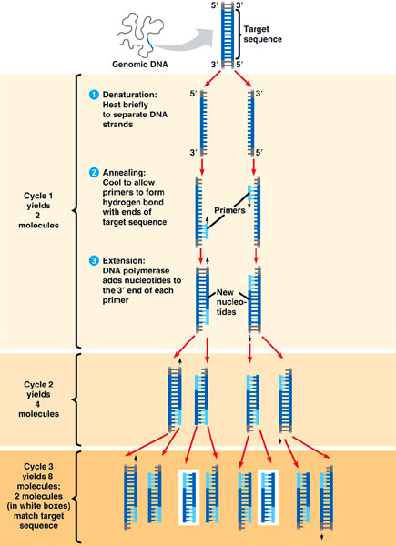
Polymerase chain reaction (PCR)
PCR amplification creates exponentially many copies of a piece of DNA in a linear number of steps.
PCR was a major enabler of the biotechnology revolution. Kary Mullis received a Nobel prize in 1993 for his work on improving the technique.
http://scienceblogs.com/insolence/2007/06/the_autism_omnibus_the_difference_betwee.php

Slide 9
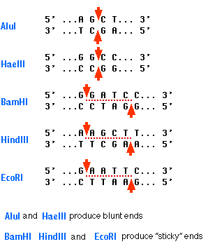
Restriction enzymes / endonucleases
A restriction enzyme is like a scissors that cuts double-stranded DNA at a specific pattern (the restriction site).
http://users.rcn.com/jkimball.ma.ultranet/BiologyPages/R/RestrictionEnzymes.html

Slide 10
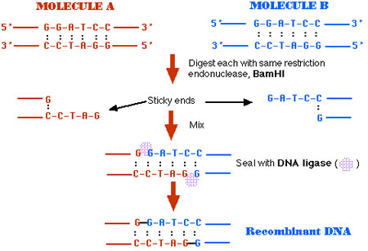
Restriction enzymes
Restriction enzymes were another enabler of the biotechnology revolution: they enable creation of recombinant DNA.
http://library.thinkquest.org/04apr/00217/en/products/recdna/about.html

Slide 11
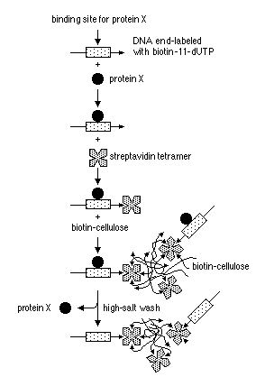
Biotin / steptavidin purification
Biotin and streptavidin form a tight, irreversible complex.
A DNA fragment is created with a high-affinity binding site for a protein of interest & a biotinylated nucleotide at one end.
The protein binds to the DNA.
The biotin binds to streptavidin that is immobilized on a bead.
Unbound protein is washed away.
The remaining complexes can be used to assay for binding activity.
http://www.currentprotocols.com/protocol/mb1206

Slide 12
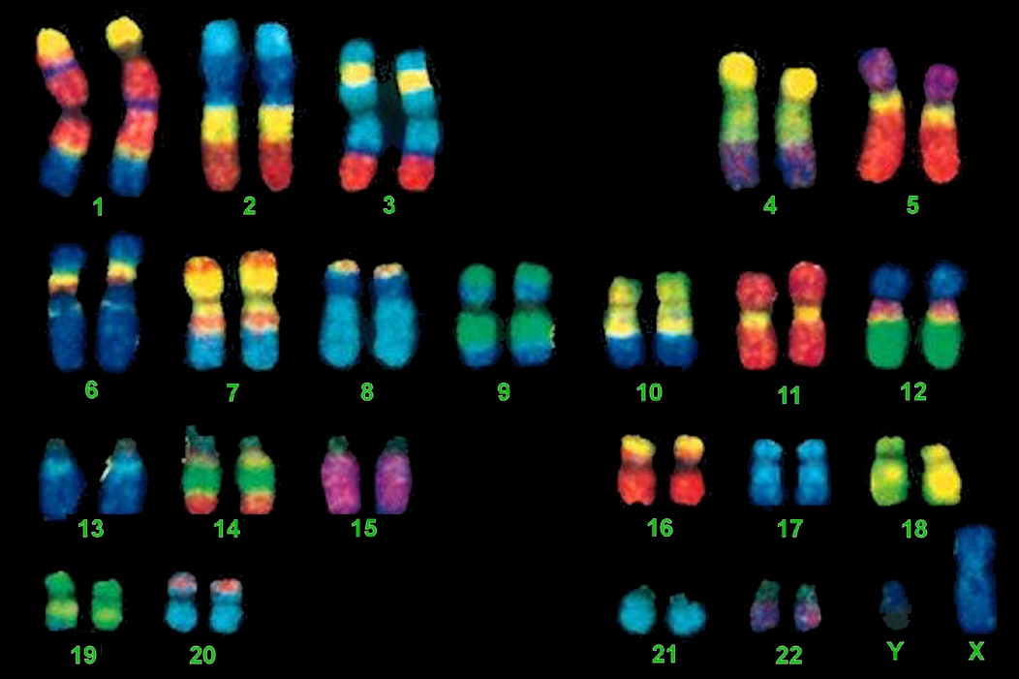
Fluorescence in situ hybridization (FISH)
Fluorescence in situ hybridization (FISH) is used to detect the presence or absence of specific DNA sequences on chromosomes and determine where on the chromosomes the sequence is located.
FISH can also be used to detect and localize specific mRNAs in tissue samples, and so can be used to determine spatio-temporal patterns of gene expression within cells and tissues.
FISH applications include genetic counseling, medicine, and species identification.
(Wikipedia: FISH)
http://www.mun.ca/biology/scarr/FISH_chromosome_painting.html

Slide 13
Outline
Context
Some biological background
Experimental technique & validation
Findings

Slide 14
Experimental technique

Slide 15
The data: Catalog of interacting pairs
The interacting fragments were sequenced using Illumina paired-end sequencing with 76bp reads.
Reads were aligned to the human hg18 reference sequence using Maq. If both ends of a pair aligned uniquely, the pair was kept.
The catalog ended up with 8.4M read pairs. Of these, 6.7M represented interactions between loci >20kb apart (i.e., long-range contacts).

Slide 16
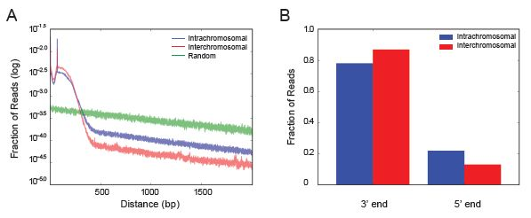
Validation: Reads near HindIII sites
Hi-C reads align near HindIII restriction sites with the correct orientation.

Slide 17
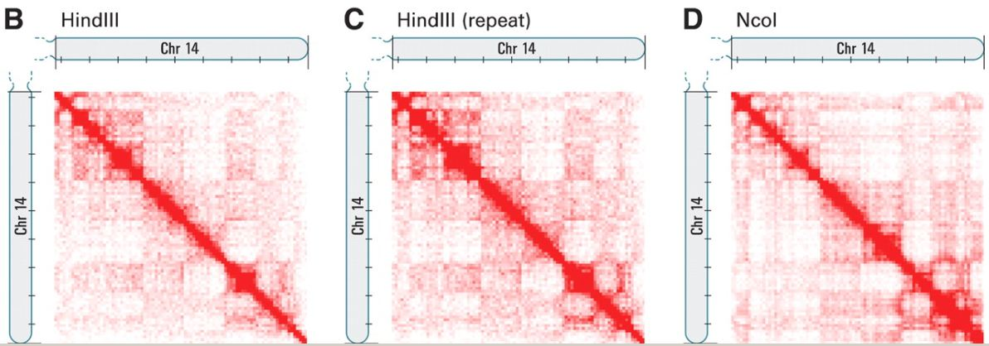
Validation: Biological repeats
Created genome-wide contact matrix M. Divided genome into 1Mb regions, set m_{ij} = # ligation products between loci i and j.
Repeated experiment with same restriction enzyme (HindIII), got essentially the same M (Pearson’s r=0.990). Repeated again with NcoI and again got same M (r=0.814).

Slide 18
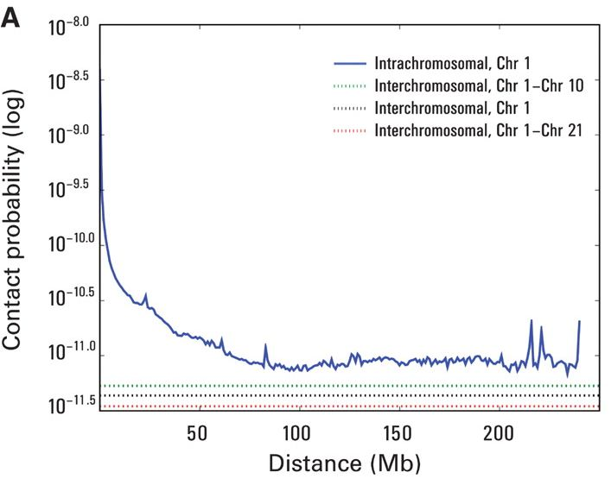
Validation: Intra-chromosomal contacts
Chromosome territories: tendency of distant loci on a chromosome to be near each other in 3D.
I_{n}(s) = Probability of contact for pair of loci separated by s base pairs on chromosome n
Decreasing on each chromosome, but
Always >> than inter-chromosomal contact probability
Confirms chromosome territories

Slide 19
Validation: Inter-chromosomal contacts

Slide 20
Outline
Context
Some biological background
Experimental technique & validation
Findings

Slide 21
Proximity of chromosome territories
Normalized contact matrix M*: divide each entry of M by genome-wide average contact probability at same distance.
Loci that are nearby in space will likely share neighbors and have correlated interaction profiles. Compute correlation matrix C with c_{ij} = Pearson correlation between M*_{i.} and M*_{.j}.

Slide 22
Correlation maps for all chromosomes

Slide 23
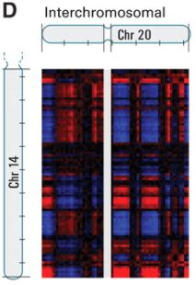
Chromosomal compartments
Partitioned each chromosome into sets A and B such that intra-set contacts are enriched and inter-set contacts are depleted.
The first PC corresponds to the plaid pattern, except
On chromosomes 4 and 5, the first PC corresponds to the two chromosome arms, the second PC to the plaid pattern.
The plaid patterns were consistent across chromosomes—can assign A and B so that:
Sets on different chromosomes with the same label had correlated profiles.
Sets with different labels had anti-correlated profiles.

Slide 24
Genome-wide compartments
Can partition the entire genome into two spatial compartments such that interactions tend to occur within rather than across compartments, i.e., loci tend to be closer in 3D if they are in the same compartment than if they are not.
Confirmed for specific cases using FISH.
The paper explores differing characteristics of the compartments such as packing density, presence of genes, expression, and chromatin accessibility.
Repeated the work with a different cell line. It also displayed two compartments with similar characteristics as in the first cell line, but with some loci in different compartments.

Slide 25
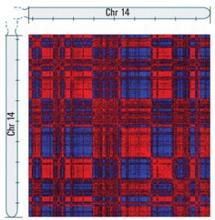
Correlation at 1Mb vs. 100kb resolution

Slide 26
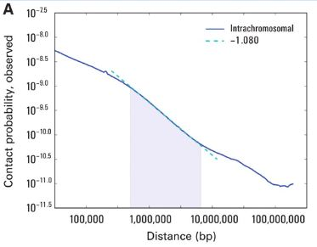
Chromatin structure within compartments
I(s) = Probability of intra-chromosomal contact for loci that are s bases apart, over the entire genome
The graph exhibits power-law scaling for s between 500kb and 7Mb (log-log axes), slope = -1.08. This is the known size range for open and closed chromatin domains.
Polymers often exhibit power-law dependencies.

Slide 27
Polymer structure of chromosomal compartment
The predominantly accepted model has been an equilibrium globule: compact, densely knotted
Alternative model is fractal globule: formed by unentangled polymer as it crumples into a series of small globules. The small globules crumple into a series of larger globules, and the process iterates. After several rounds, a single multi-level globule is formed.
The fractal globule is an appealing model because it does not have knots. This facilitates unfolding & refolding as necessary during the chromosome’s activities.

Slide 28
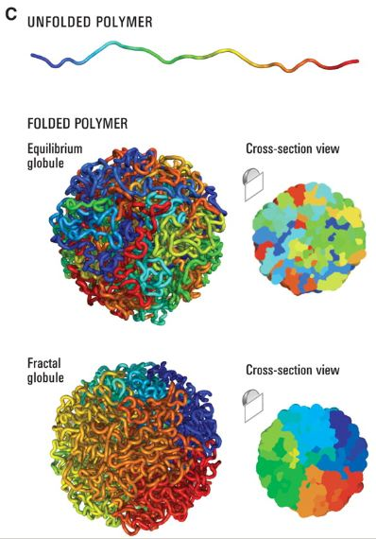
Globular structures
Fractal: Contiguous regions of the genome form spatial areas whose size corresponds to the length of the linear region
Equilibrium: Highly knotted, little correlation between linear and spatial regions

Slide 29
Self-similarity of fractal globule

Slide 30
Predictions based on different globule models
Feature | Equilibrium | Fractal | Observed
Scaling of contact probability with genomic distance s | s^{-3/2} | s⁻¹ | s^{-1.08}
3D distance between pairs of loci | s^{1/2} | s^{1/3} | s^{1/3}

Slide 31
Conclusions
At the scale of several megabases, the data are consistent with a fractal globule model for chromatin organization rather than an equilibrium globule model. Cannot rule out other models with regular organization.
Could use the same approach at higher resolution by increasing the number of reads, and so map long-range interactions between specific DNA features such as enhancers and silencers.
Increasing resolution by a factor of n requires increasing the number of reads by a factor of n². Can do this as sequencing technology and cost improve, or can use current technology to focus on subregions.

